Slide 1
CLOUD COMPUTING
PROJECT -1
DEPLOY
STATIC
WEBSITE
ON
AWS

Slide 2

WHAT IS STATIC WEBSITE
A static website is a website that serves pages using a fixed number of pre-built files composed of HTML, CSS, and JavaScript.
A static website has no backend server-side processing and no database. Any “dynamic” functionality associated with the static site is performed on the client side, which means the code is executed in visitors’ browsers rather than on the server.
In non-technical terms, this means that your hosting delivers the website files to visitors’ browsers exactly as those files appear on the server.
What’s more, every single visitor gets the same static file delivered to their browsers, which means they’ll largely have the exact same experiences and see the exact same content.
Static websites are a great choice for projects with simple needs and limited resources. Check out this guide to see if it's the right fit for you

Slide 3
WHAT THING DO TO DEPLOY STATIC WEBSITE
1- CREATE A BUCKET
2- UPLOAD WEBSITE FILES
3- HOST WEBSITE IN S3
4- TEST IN BROWSER

Slide 4
STEPS FOLLOW AND CREAT STATIC WEBSITE AND ALSO DEPLOY
Task 1: Sign in to AWS Management Console
1 - Click on the Open Console button, and you will get redirected to AWS Console in a new browser tab.
2- On the AWS sign-in page,
  Leave the Account ID as default. Never edit/remove the 12-digit Account ID present in the AWS Console. otherwise, you cannot proceed with the lab.
  Now copy your User Name and Password in the Lab Console to the IAM Username and Password in AWS Console and click o the Sign in button.
  3- Once Signed In to the AWS Management Console, Make the default AWS Region as US East (N. Virginia) us-east-1.

Slide 5
Task 2: Creating a S3 Bucket
In this task, we are going to create a new S3 bucket in the US East (N. Virginia) region with a unique name disabling ACLs, and allowing public access for hosting the static website.
1-- Navigate to S3 by clicking on the Services menu at the top, then click on S3 in the Storage section.
2--In the S3 dashboard, click on the Create Bucket button.
3--In the General Configuration, Bucket name: Enter abcxyz
Note: S3 Bucket names are globally unique, choose a name that is available. Maybe you can enter your name and create one.
4—AWS Region: Select US East (N. Virginia) us-east-1
5--Object ownership: Select ACLs disabled (recommended) option
In the option of Block Public Access settings for this bucket, Uncheck the option of Block all public access.
6-- Check the I acknowledge that the current settings might result in this bucket and the objects within becoming public checkbox.
7--. Keep everything default and click on Create Bucket button.

Slide 6
Task 3: Enable Static Website Hosting settings
In this task, we will enable static website hosting for our S3 bucket, configure it to use index.html and error.html, copy the provided endpoint, upload two files, and configure the bucket policy by copying its ARN and past provided policy code
.
1-- To proceed, go to the S3 bucket name that you created and click on it. After that, navigate to the Properties tab which can be found at the top of the screen
.
2-- Scroll down to the Static website hosting section and click on Edit button.

Slide 7
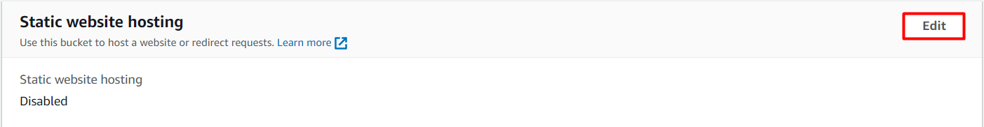
In the Static website hosting dialog box
Static website hosting: Select Enable
Hosting type: Choose Host a static website
Index document: Type index.html
Error document: Type error.html
Click on Save Changes.

Slide 8
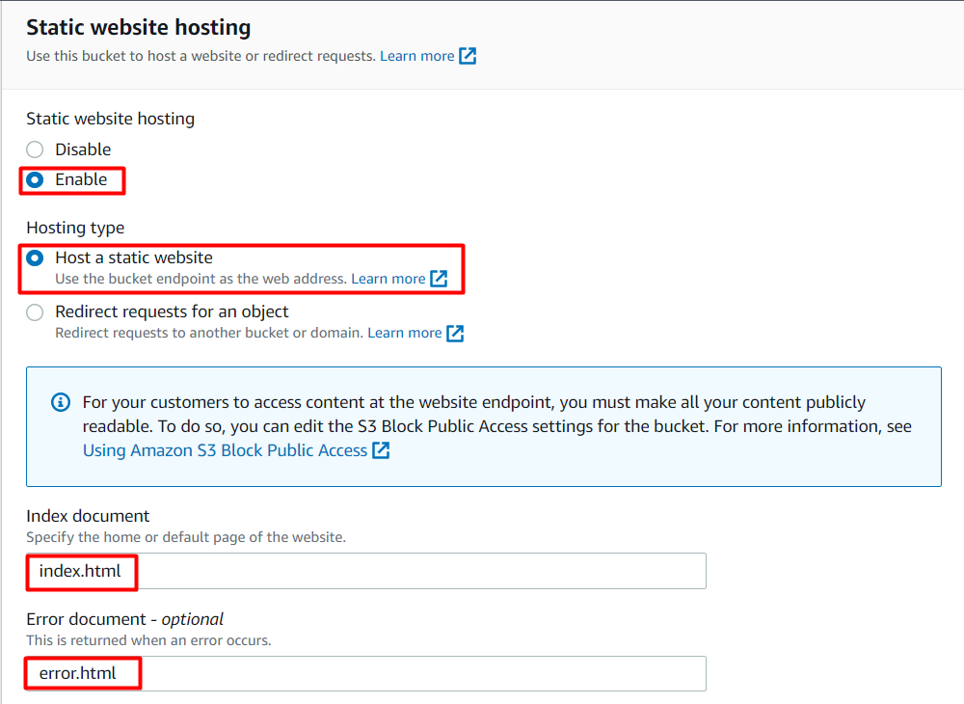
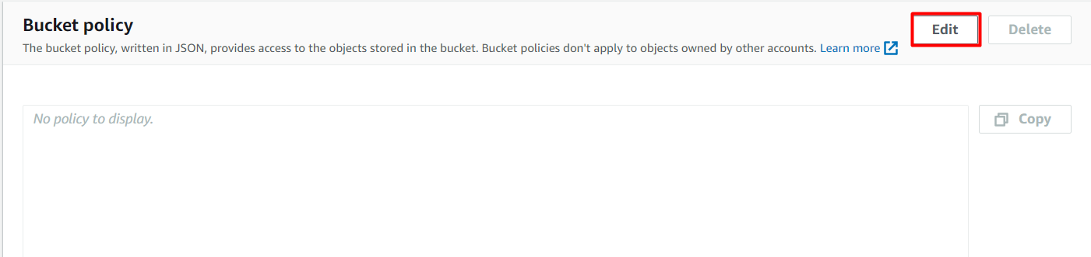
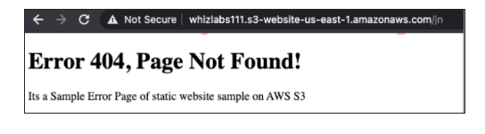
6. To configure your S3 bucket, access the Permissions tab and make the necessary configurations.
In the Permissions tab, Click on the Edit button beside the Bucket Policy.
You will be able to see a Blank policy editor.
Before creating the policy, you will need to copy the ARN (Amazon Resource Name) of your bucket.
Copy the ARN of your bucket to the clipboard. It is displayed at the top of the policy editor. it will look like ARN:“arn:aws:s3:::your-bucket-name".
In the policy below, Update the bucket ARN on the Resource key value and paste the below policy code in the editor.
{
"Id":"Policy1",
"Version":"2012-10-17",
"Statement":[
{
"Sid":"Stmt1",
"Action":[
"s3:GetObject"
],
"Effect":"Allow",
"Resource":"replace-this-string-with-your-bucket-arn/*",
"Principal":"*"
}
]
}
Click on Save changes button.
Task 4: Test the website
Now copy the static website URL (that we saved earlier) and run it in your browser. You will be able to see the index.html file's text. A sample screenshot is attached below:
Task 5: Test the website's error page
Copy the static website URL (which we saved earlier) , but this time, add some random characters to the end of the url to break it. When satisfied, hit [Enter]. You will be redirected to the error.html page automatically.

Slide 9
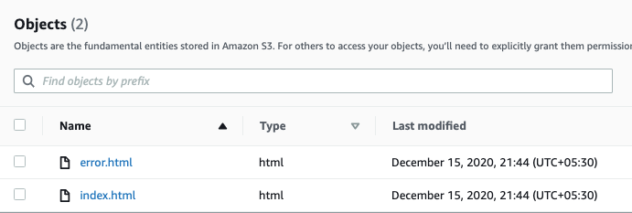
4. Go to the Properties tab of your S3 bucket, and find the Static website hosting section. Copy the Endpoint provided in this section to your clipboard and save it for future reference.
5. The next step is to download the zip file by clicking on the link, extract it, and upload two files named index.html and error.html to the S3 bucket you created earlier.
.
  .

Slide 10
You will be able to see a Blank policy editor
.
Before creating the policy, you will need to copy the ARN (Amazon Resource Name) of your bucket.
Copy the ARN of your bucket to the clipboard. It is displayed at the top of the policy editor. it will look like ARN:“arn:aws:s3:::your-bucket-name".
In the policy below, Update the bucket ARN on the Resource key value and paste the below policy code in the editor.
{
"Id":"Policy1",
"Version":"2012-10-17",
"Statement":[
{
"Sid":"Stmt1",
"Action":[
"s3:GetObject"
],
"Effect":"Allow",
"Resource":"replace-this-string-with-your-bucket-arn/*",
"Principal":"*"

Slide 11
:
Click on Save changes button.
Task 4: Test the website
Now copy the static website URL (that we saved earlier) and run it in your browser. You will be able to see the index.html file's text
.
A sample screenshot is attached below
Task 5: Test the website's error Copy the static website URL (
which we saved earlier) , but this time, add some random characters to the end of the url to break it. When satisfied, hit [Enter]. You will be redirected to the error.html page automatically.

Slide 12

The End of presentation project-1
thank
you

